Slide 1
Logistics Optimization for Delivery Routes – Flipkart
Dipjyoti Shil
Submitted by -
09/05/2026

Slide 2
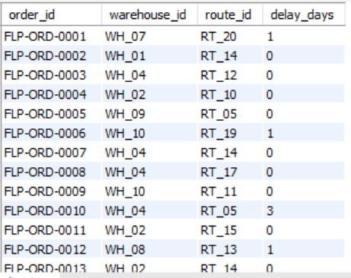
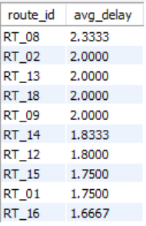
Delivery Delay Analysis
Insights
While most deliveries are on time, a few routes consistently experience higher delays, suggesting operational or traffic-related inefficiencies.
Delivery delay for each days
SELECT
order_id, warehouse_id, route_id, DATEDIFF(actual_delivery_date, expected_delivery_date)
AS delay_days FROM orders;
Top 10 delayed routes
SELECT route_id,
AVG(delay_days) AS avg_delay FROM order_delay WHERE delay_days > 0 GROUP BY route_id ORDER BY avg_delay DESC LIMIT 10;
Analysis Approach
Calculated delivery delay using actual vs expected delivery date
Identified delay (in days) for each order
Analyzed route-level delay patterns

Slide 3
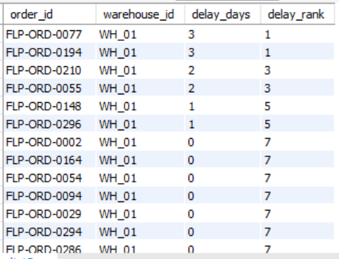
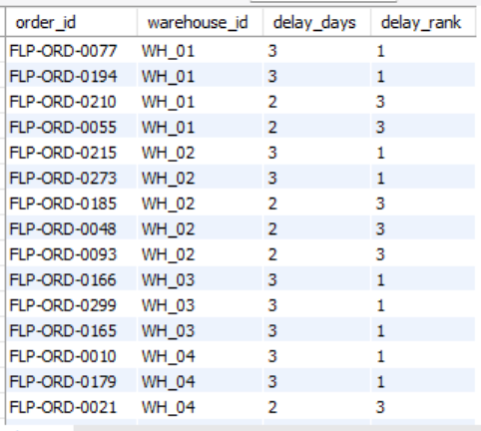
Delivery Delay Analysis
Insights
Warehouse-level ranking shows that delays are concentrated among a few orders, indicating targeted operational issues rather than overall warehouse inefficiency.
Ranking all orders by delay
SELECT
order_id,warehouse_id,delay_days,
RANK() OVER (PARTITION BY warehouse_id
ORDER BY delay_days DESC) AS delay_rank
FROM order_delay;
Analysis Approach
Used RANK() window function to rank orders by delay
Partitioned data by warehouse to compare internally
Identified top delayed orders within each warehouse
Ranking all orders by delay(Better version)
SELECT*FROM
(SELECT order_id,warehouse_id,delay_days, RANK() OVER (PARTITION BY warehouse_id ORDER BY delay_days DESC) AS delay_rank FROM order_delay) t WHERE delay_rank <= 3;

Slide 4
Delivery Delay Analysis
Insights
Most deliveries are completed on time, but delays are concentrated in specific routes
A small number of routes contribute to the majority of delivery delays
Warehouse-level ranking shows delays are caused by specific orders, not overall inefficiency
Delay patterns suggest possible traffic congestion or poor route planning
Certain warehouses repeatedly appear in delayed orders, indicating localized bottlenecks
Recommendations
Focus on optimizing high-delay routes instead of entire network
Improve route planning using traffic-aware scheduling
Monitor and investigate frequently delayed orders for root causes
Enhance coordination in warehouses showing repeated delays
Implement real-time tracking and alerts for delayed shipments

Slide 5
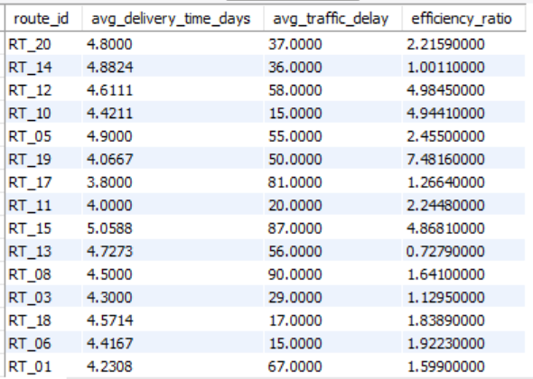
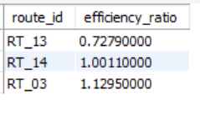
Route Optimization Insights
Insights
Routes with low efficiency ratios and high traffic delays require optimization to improve delivery performance.
Route Performance Metrics Analysis
SELECT
o.route_id,
AVG(DATEDIFF(o.actual_delivery_date, o.order_date))
AS avg_delivery_time_days, AVG(r.traffic_delay_min)
AS avg_traffic_delay, AVG(r.distance_km / r.average_travel_time_min) AS efficiency_ratio
FROM orders o JOIN routes r
ON o.route_id = r.route_id GROUP BY o.route_id;
Analysis Approach
Calculated average delivery time for each route
Measured average traffic delay across routes
Computed efficiency ratio using Distance_KM / Average_Travel_Time_Min
Compared route efficiency to identify low-performing routes
3 Worst Efficiency Routes Identification
SELECT
o.route_id,
AVG(r.distance_km / r.average_travel_time_min)
AS efficiency_ratio FROM orders o JOIN routes r
ON o.route_id = r.route_id GROUP BY o.route_id
ORDER BY efficiency_ratio ASC LIMIT 3;

Slide 6
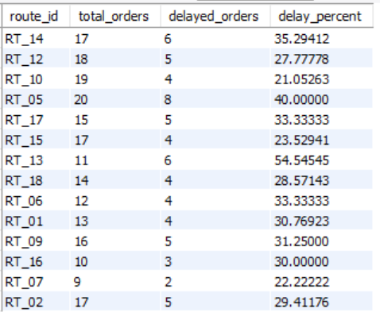
Route Optimization Insights
High Delay Route Analysis
SELECT
route_id, COUNT(*) AS total_orders,
SUM(CASE WHEN actual_delivery_date > expected_delivery_date THEN 1 ELSE 0 END) AS delayed_orders,
(SUM(CASE WHEN actual_delivery_date > expected_delivery_date THEN 1 ELSE 0 END) * 100.0 / COUNT(*))
AS delay_percent FROM orders GROUP BY route_id
HAVING delay_percent > 20;
Insights
Routes with high delay percentages require immediate optimization to improve on-time delivery performance.
Analysis Approach
Calculated delayed shipment percentage for each route
Identified routes with more than 20% delayed deliveries
Highlighted high-risk routes for operational improvement

Slide 7
Route Optimization Insights
Insights
Several routes have high delivery delays and poor efficiency ratios
Traffic congestion is a major factor affecting route performance
RT_13, RT_14, and RT_03 are the least efficient routes
Some routes exceed 20% delayed shipments, affecting delivery reliability
Inefficient route planning increases delivery time and operational cost
Recommendations
Optimize low-efficiency routes using alternate path planning
Schedule deliveries during low-traffic hours to reduce delays
Monitor high-delay routes regularly through KPI tracking
Improve route allocation based on traffic and travel time analysis
Use real-time traffic data for smarter delivery planning
Prioritize operational improvements on routes with high delay percentages
Enhance coordination between warehouses and delivery teams

Slide 8
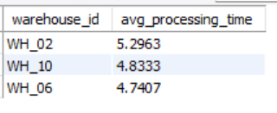
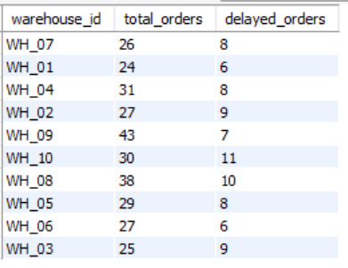
Warehouse Performance
Insights
Warehouses with higher processing times also show increased delayed shipments, indicating operational bottlenecks
affecting delivery performance.
Top 3 Highest Average Processing Time
SELECT
warehouse_id, AVG(DATEDIFF(actual_delivery_date, order_date)) AS avg_processing_time FROM orders
GROUP BY warehouse_id
ORDER BY avg_processing_time DESC LIMIT 3;
Analysis Approach
Calculated average processing time for each warehouse using order and delivery dates
Identified top 3 warehouses with the highest processing time
Compared total shipments with delayed shipments across warehouses
Warehouse Shipment Delay Comparison
SELECT
warehouse_id, COUNT(*) AS total_orders, SUM(CASE WHEN actual_delivery_date > expected_delivery_date
THEN 1 ELSE 0 END) AS delayed_orders
FROM orders GROUP BY warehouse_id;

Slide 9
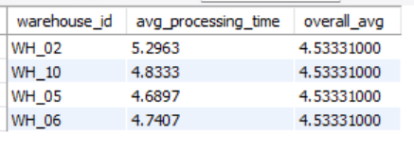
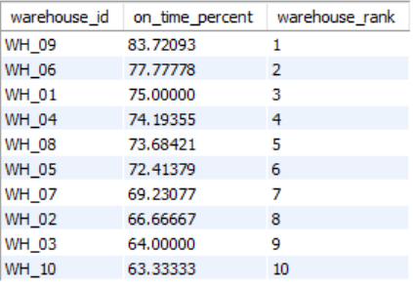
Warehouse Performance
Insights
Warehouses with processing times above the global average generally show lower on-time delivery performance, highlighting the need for process optimization and faster order handling.
Bottleneck Warehouse Identification Using CTEs
WITH warehouse_avg AS (
SELECT warehouse_id,
AVG(DATEDIFF(actual_delivery_date, order_date)) AS avg_processing_time
FROM orders GROUP BY warehouse_id),global_avg AS
( SELECT AVG(avg_processing_time) AS overall_avg FROM warehouse_avg)
SELECT*FROM warehouse_avg, global_avg WHERE warehouse_avg.avg_processing_time > global_avg.overall_avg;
Warehouse On-Time Delivery Ranking
SELECT
warehouse_id, (SUM(CASE
WHEN actual_delivery_date <= expected_delivery_date
THEN 1 ELSE 0 END) * 100.0 / COUNT(*)) AS on_time_percent,
RANK() OVER (ORDER BY (SUM(CASE
WHEN actual_delivery_date <= expected_delivery_date
THEN 1 ELSE 0 END) * 100.0 / COUNT(*)) DESC)
AS warehouse_rank FROM orders GROUP BY warehouse_id;
Analysis Approach
Used CTEs to compare warehouse processing time with the global average
Identified bottleneck warehouses where processing time exceeded overall average
Ranked warehouses based on on-time delivery percentage using window functions

Slide 10
Warehouse Performance
Insights
WH_02 recorded the highest average processing time among all warehouses
Bottleneck warehouses showed lower on-time delivery percentages
Delayed shipments are concentrated in a few underperforming warehouses
Warehouses with faster processing achieved better delivery performance
Operational inefficiencies directly impacted customer delivery timelines
Recommendations
Improve warehouse processing workflows to reduce handling time
Allocate additional staff/resources to bottleneck warehouses during peak periods
Implement real-time monitoring for shipment processing and delays
Optimize inventory arrangement and dispatch operations for faster movement
Conduct periodic performance reviews for low-ranked warehouses to improve efficiency

Slide 11
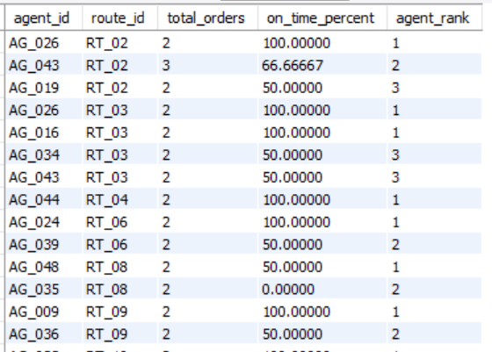
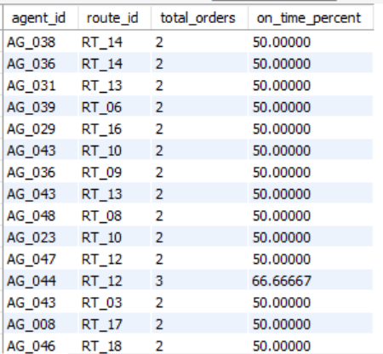
Delivery Agent Performance
Insights
Agent performance varies significantly across routes, and a few low-performing agents are contributing disproportionately to delivery delays.
Delivery Agent On-Time Performance Ranking
SELECT
agent_id, route_id, COUNT(*) AS total_orders, (SUM(CASE WHEN actual_delivery_date <= expected_delivery_date
THEN 1 ELSE 0 END) * 100.0 / COUNT(*)) AS on_time_percent, RANK() OVER (PARTITION BY route_id ORDER BY (SUM(CASE WHEN actual_delivery_date <= expected_delivery_date
THEN 1 ELSE 0 END) * 100.0 / COUNT(*)) DESC)
AS agent_rank FROM orders GROUP BY agent_id, route_id HAVING COUNT(*) >= 2;
Analysis Approach
Calculated on-time delivery percentage for each delivery agent by route
Ranked agents within each route using SQL window functions
Identified low-performing agents with on-time delivery below 80%
Low Performing Delivery Agents Identification
SELECT
agent_id, route_id, COUNT(*) AS total_orders, (SUM(CASE WHEN actual_delivery_date <= expected_delivery_date
THEN 1 ELSE 0 END) * 100.0 / COUNT(*)) AS on_time_percent FROM orders GROUP BY agent_id, route_id
HAVING COUNT(*) >= 2 AND on_time_percent < 80;

Slide 12
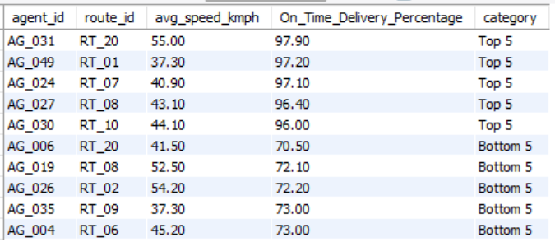
Delivery Agent Performance
Top vs Bottom Agent Speed Performance Comparison
SELECT *FROM (SELECT
agent_id, route_id, avg_speed_kmph, On_Time_Delivery_Percentage, 'Top 5' AS category FROM delivery_agents ORDER BY On_Time_Delivery_Percentage DESC LIMIT 5) AS top_agents UNION ALL SELECT *FROM (SELECT
agent_id, route_id, avg_speed_kmph, On_Time_Delivery_Percentage, 'Bottom 5' AS category FROM delivery_agents ORDER BY On_Time_Delivery_Percentage ASC LIMIT 5) AS bottom_agents;
Delivery Agent Performance Improvement Recommendations
Provide targeted training for agents with on-time delivery below 80%
Assign experienced high-performing agents as mentors for low performers
Reduce workload on consistently low-performing agents during peak hours
Reassign difficult or high-traffic routes more evenly among agents
Monitor agent performance regularly using on-time delivery KPIs
Optimize route allocation based on agent efficiency and route familiarity
Analysis Approach
Compared top 5 and bottom 5 delivery agents based on on-time delivery percentage
Used subqueries to separate high-performing and low-performing agents
Analyzed average speed alongside delivery performance metrics

Slide 13
Delivery Agent Performance
Insights
On-time delivery performance varies significantly among delivery agents
Top-performing agents consistently maintain high delivery percentages across routes
Some low-performing agents show lower delivery percentages despite similar average speeds
Delivery delays are influenced by both agent efficiency and route conditions
A small group of low-performing agents contributes disproportionately to delayed deliveries
Higher delivery speed alone does not always guarantee better on-time performance
Recommendations
Provide targeted training for agents with on-time delivery below 80%
Assign experienced top-performing agents as mentors for low performers
Balance route allocation to avoid overloading specific delivery agents
Reassign high-traffic or difficult routes based on agent experience and performance
Monitor agent KPIs regularly to track improvement in delivery performance
Conduct time-management and route-handling workshops for low-performing agents
Introduce incentive programs for agents achieving high on-time delivery rates

Slide 14
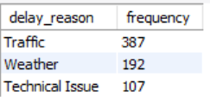
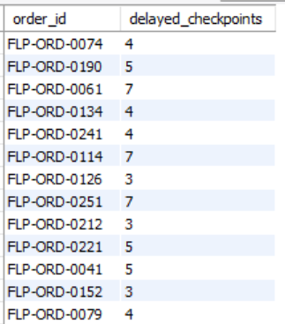
Shipment Tracking Analytics
Insights
Traffic and weather are the major causes of shipment delays, while orders with multiple delayed checkpoints indicate recurring operational inefficiencies in the delivery process.
Most Common Delivery Delay Reasons Analysis
SELECT
delay_reason, COUNT(*) AS frequency FROM shipment_tracking
WHERE delay_reason IS NOT NULL
AND delay_reason != 'None’
GROUP BY delay_reason
ORDER BY frequency DESC;
Analysis Approach
Analyzed shipment tracking data to identify the most common delivery delay reasons
Excluded NULL and “None” values to focus only on actual delay causes
Counted delayed checkpoints for each order to identify shipments with repeated delays
Orders with Multiple Delayed Checkpoints Identification
SELECT
order_id, COUNT(*) AS delayed_checkpoints FROM shipment_tracking
WHERE delay_reason IS NOT NULL
AND delay_reason != 'None’
GROUP BY order_id HAVING COUNT(*) > 2;

Slide 15
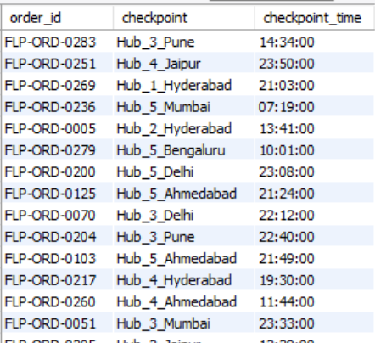
Shipment Tracking Analytics
Orders with Multiple Delayed Checkpoints Identification
SELECT
order_id, checkpoint, checkpoint_time FROM shipment_tracking
WHERE (order_id, checkpoint_time)
IN (SELECT order_id, MAX(checkpoint_time) FROM shipment_tracking GROUP BY order_id);
Analysis Approach
Analyzed shipment tracking data to identify the most common delivery delay reasons
Excluded NULL and “None” values to focus only on actual delay causes
Counted delayed checkpoints for each order to identify shipments with repeated delays
Insights
Traffic and weather are the major causes of shipment delays, while orders with multiple delayed checkpoints indicate recurring operational inefficiencies in the delivery process.

Slide 16
Shipment Tracking Analytics
Insights
Traffic is the most common cause of shipment delays across checkpoints
Weather-related disruptions significantly impact delivery timelines
Technical issues also contribute to repeated shipment delays
Several orders experience multiple delayed checkpoints, indicating recurring delivery bottlenecks
Repeated checkpoint delays reduce shipment visibility and overall customer satisfaction
Certain hubs/routes appear more delay-prone and require operational attention
Recommendations
Improve route planning to reduce traffic-related delays
Introduce real-time traffic and weather monitoring for better shipment scheduling
Strengthen technical infrastructure to minimize system-related disruptions
Monitor orders with repeated delayed checkpoints more closely
Optimize checkpoint operations at high-delay hubs for faster shipment movement
Implement automated alerts for shipments facing multiple delays
Use predictive analytics to identify potential delays before escalation

Slide 17
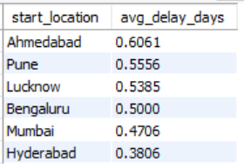
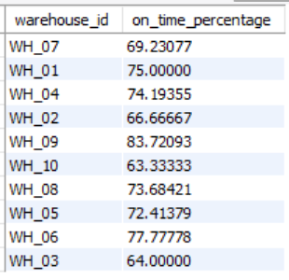
Insights
Certain start locations consistently show higher average delivery delays, while warehouse on-time delivery percentages vary significantly, indicating differences in operational efficiency across the supply chain.
Advanced KPI Reporting
Average Delivery Delay by Start Location Analysis
SELECT
r.start_location, AVG(DATEDIFF
(o.actual_delivery_date,o.expected_delivery_date))
AS avg_delay_days FROM orders o
JOIN routes r ON o.route_id = r.route_id
GROUP BY r.start_location
ORDER BY avg_delay_days DESC;
Analysis Approach
Calculated average delivery delay for each start location using route and order data
Compared warehouse on-time delivery percentages to evaluate operational performance
Analyzed KPI metrics to identify high-delay locations and low-performing warehouses
Warehouse On-Time Delivery Percentage Analysis
SELECT
warehouse_id, (SUM(CASE WHEN
actual_delivery_date <= expected_delivery_date
THEN 1 ELSE 0 END) * 100.0 / COUNT(*))
AS on_time_percentage FROM orders
GROUP BY warehouse_id;

Slide 18
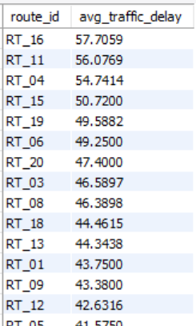
Advanced KPI Reporting
Insights
Routes with consistently high average traffic delays indicate traffic congestion hotspots that negatively impact overall delivery efficiency and on-time performance.
Average Traffic Delay per Route Analysis
SELECT
o.route_id, AVG(s.Delay_Minutes)
AS avg_traffic_delay FROM shipment_tracking s JOIN orders o ON s.order_id = o.order_id GROUP BY o.route_id
ORDER BY avg_traffic_delay DESC;
Analysis Approach
Calculated average traffic delay minutes for each route using shipment tracking data
Joined shipment tracking and orders tables to map delays with route IDs
Compared routes based on average traffic delay to identify congestion-prone routes

Slide 19
Advanced KPI Reporting
Insights
Ahmedabad and Pune show the highest average delivery delays among start locations
Warehouse on-time delivery performance varies significantly, indicating operational inconsistency across warehouses
Certain routes experience consistently high traffic delays, reducing overall delivery efficiency
High traffic delay routes are strongly linked with delayed deliveries and lower service performance
Warehouses with lower on-time percentages may be contributing to shipment bottlenecks and customer dissatisfaction
Recommendations
Optimize routes with high traffic delays using alternate paths and dynamic route planning
Improve warehouse processing efficiency in low-performing warehouses through better resource allocation
Increase monitoring of high-delay start locations to reduce recurring delivery delays
Implement real-time traffic tracking systems for faster route adjustments during deliveries
Standardize warehouse operations and delivery processes to improve on-time delivery consistency

Slide 20
THANK
YOU

